Slide 1
Global Citizenship in Theory and Practice by Hans Schattle
November 2015
Görkem Atsungur, American University of Central Asia

Slide 2
Why Schattle?
Schattle’s article provides basic understanding of the concept of global citizenship—its historical origins, ethical and moral implications, and contemporary global challenges.
It gives a general overview LR on the concept(s).
It discusses academic debates (both normative and empirical ones).
It raises several important questions on the implication of the concept.
It contains key elements (knowledge & understanding, skills, values & attitudes) of education on global citizenship.

Slide 3
Global Citizenship in Theory and Practice
(1) Historical Evolution: Origins and Development of the Cosmopolitan Tradition and Ideals.
(2) Contemporary Understandings of Global Citizenship: Normative vs. Empirical debate(s).
(3) Interpretations of Global Citizenship in the present day.
(4) Conclusion

Slide 4
Global Citizenship in Theory and Practice:
I. Historical Evolution
Ancient Greece: Non-political view of world citizenship
Etymology: Cosmopolitan means ‘Order’, ‘Universe’, and ‘Citizen.’
Socrates and Diogenes – Citizens of the world.
Ancient Rome : Ethical view on world citizenship
Ideals of ‘universal law’ and ‘civic virtue’
Roman Stoic thinkers: Cicero, Marcus Aurelius, Seneca, etc.
Dual civic life: (1) obligations to the state and (2) virtuous human person.

Slide 5
Global Citizenship in Theory and Practice
I. Historical Evolution
Medieval Christian Europe: Moral view of world citizenship
St. Augustine - City of God: Moral Universalism
Age of Enlightenment
American and French Revolutions
Immanuel Kant: Cosmopolitan right and Perpetual peace (1795)

Slide 6
Global Citizenship in Theory and Practice
I. Historical Evolution
20th Century – International dimensions of world citizenship
Global governing institutions: The UN (world peace and nuclear disarmament, human rights for all, etc.)
Cold War limitations
1980s – New Model of Global Citizenship: Universal human community.
1990s – Demise of the SU and Democratic Transformations in the world (South Africa, South Korea, and CEE countries).

Slide 7
Global Citizenship in Theory and Practice
II. Contemporary Understandings
Richard Falk (1994), ‘The making of global citizenship’ & John Urry (2000), ‘Sociology beyond societies’
Extensive International Travel (openness)
Global Activists (Think globally, Act locally)
Global Reformers (Accountable global governing institutions)
Global Managers (International Institutions – Borderless problems)
Global Capitalist (Denationalized global elite)
Global Educators (Inspiring young people to think and live as global citizens)

Slide 8
Global Citizenship in Theory and Practice
II. Contemporary Understandings
Academic debate(s)
(1) A Normative debate by political philosophers and social theorists on ethics of world citizenship (international migration and transnational activism).
(2) An Empirical debate by sociologist and IR scholars of legal perspectives of world citizenship.

Slide 9
Global Citizenship in Theory and Practice
II. Contemporary Understandings
A. Normative Debate:
Classical Liberal principles such as liberty, equality, and justice.
North America: Moral and ethical terms (habits and choices of individuals).
Martha Nussbaum (1996), ‘Patriotism and cosmopolitanism’ - advocates world citizenship rather than state or national citizenship. She focuses on civic education and promotes individual and collective self-awareness with moral obligations. She fosters moral sentiments for international distributive justice.

Slide 10
Global Citizenship in Theory and Practice
II. Contemporary Understandings
David Held (1995, 1999) - ‘Cosmopolitan Democracy’
States should be no longer be the exclusive power center. There should be a global legal framework with an elected worldwide assembly by international judiciary, military force, and economic-political institutions.
+ Conceptual enlargement of citizenship within transnational civil society.
A. Linklater (1999), ‘Cosmopolitan citizenship’– dialogic conception solutions to common global problems.

Slide 11
Global Citizenship in Theory and Practice
II. Contemporary Understandings
B. Empirical Debate:
Citizenship status: is it a matter of choice or accident of birth?
Transnational activism – global civic engagement as a matter of choice.
National citizenship devolution and possible model of post-national membership: Yasemin Soysal (1994), David Jacobson (1996), Christian Joppke (1998), Saskia Sassen (1999), and Randall Hansen (1999).
International migration and legal protection granted to migrants.

Slide 12
Global Citizenship in Theory and Practice
II. Contemporary Understandings
M. Keck & K. Sikkink (1998), ‘Activists beyond borders’ – ‘Boomerang Effect’ where non-state actors in international arena also carry some implications for state sovereignty.
M. Edwards & J. Gaventa (2001), ‘Global Citizen Action’ - advocacy work on an international scale with the idea of global citizenship.
Possible implications of transnational political and social activism for citizenship.
U. Beck (1999), ‘What is globalization’ - distinguishing b/w global capitalist and global citizens.
Boli & Thomas (1997, 1999) – International NGOs and the mandate of world citizenship.

Slide 13
Global Citizenship in Theory and Practice
III. Interpretation(s)
How individuals do consider themselves as global citizens?
How organizations and institutions do adopt the term of global citizenship?
The primary concepts of global citizenships are: Awareness, Responsibility, and Engagement.

Slide 14
Global Citizenship in Theory and Practice
III. Interpretation(s)
The Practices of Global Citizenship (2008)
More than 150 interviews
Awareness -> “when you became self-aware; you became more aware of others”
Global citizenship has nothing to do with acquiring or giving up national citizenship but it is an awareness.
Responsibility -> Shared moral obligations: Respect HR, and Solidarity across humanity.
Global citizenship is the aware of those moral responsibilities.

Slide 15
Global Citizenship in Theory and Practice
III. Interpretation(s)
Political and/or Social Engagement:
Interest in transnational political activism.
Feel a sense of kinship with humankind.
Political significance of cross-cultural empathy: politically active global citizens influence the practices and decisions of governing institutions.
Global citizenship not only involves thinking about someone else but also involves sharing one’s heritage.

Slide 16
Global Citizenship in Theory and Practice
III. Interpretation(s)
International Mobility: distance from one’s country of origin.
Migration and detachment of national identity.
Feel disengaged and not have a strong sense of place.
Enthusiasm for international travel and feeling.

Slide 17
Global Citizenship in Theory and Practice
IV. Conclusion
Interpretation of the meaning of global citizenship: moral visions of citizenship and cosmopolitanism as political and social ideas.
Robust model of citizenship for the 21st century even though nationalism remains as one of the most powerful sources of political belonging.
The current era of globalization (IT, Traveling, MC): global governance and collaboration in solving shared global problems.

Slide 18
Global Citizenship in Theory and Practice
IV. Conclusion
The idea of global citizenship on higher education: Advancing public understanding of global citizenship and inspiring young people to think and live as global citizens.
Younger generations are more actively engaged participant and morally responsible member.
Making difference in levels of awareness, responsibility, and participation.

Slide 19
Questions
What does it mean to be a “global citizen” or a citizen of a global era?
How does the concept of global citizenship affect the everyday lives of individuals, organizations, and governments?
How are the rights and responsibilities of citizens changing?
How are forces of cosmopolitanism impacting local, regional, and national identities?

Slide 21
Global Citizenship in Theory and Practice
Bhikhu Parekh – ‘Cosmopolitanism and global citizenship’ (2003) Why and what obligations we have to people outside our political community and how best to discharge them – obligations, ethics of interdependence, globally oriented citizenship.
Will Kymlicka & Wayne Norman – ‘Citizenship in culturally diverse societies’ (2000): Minority Rights, Citizenship, and Ethnic Conflict Management.

Slide 22
Global Citizenship
‘Before you finish eating breakfast this morning, you've depended on more than half the world. ’ Martin Luther King - Globalization and interdependence
‘ We all live with the objective of being happy; our lives are all different and yet the same. ’ Anne Frank – Diversity
‘ If you are neutral in situations of injustice, you have chosen the side of the oppressor. If an elephant has its foot on the tail of a mouse and you say that you are neutral, the mouse will not appreciate your neutrality. ’ Desmond Tutu - Social justice and equity
‘There is enough in the world for everyone’s need, but not for everyone’s greed. ’ Mahatma Gandhi - Sustainable development
‘ Peace, in the sense of absence of war, is of little value to someone who is dying of hunger or cold. Peace can only last where human rights are respected, where people are fed, and where individuals and nations are free. ’ The 14th Dalai Lama - Peace and conflict

Slide 23
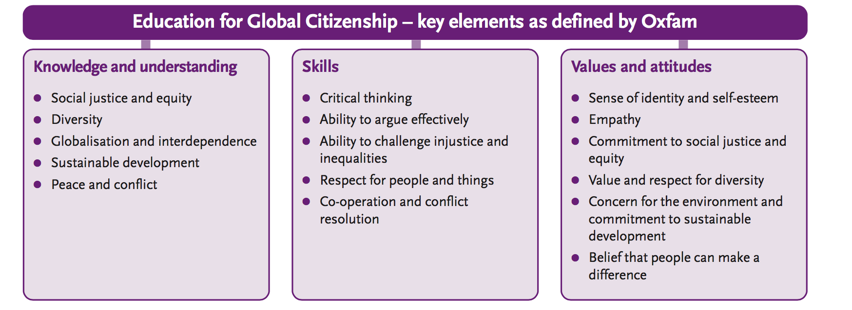

Slide 24
How to teach Global Citizenship?
Issue tree - a way of structuring an enquiry to encourage students to explore the causes, effects and solutions of a given issue.
Interrogating photographs and artefacts
Why-why-why chain - thinking beyond surface impressions to the underlying causes of any issue.
Consequences wheel - a type of mind-map which can help students think through the consequences of an event, action or issue.
Opinion continuum - a simple way of encouraging students to think through their position on two opposing views about an issue.

