Slide 1
Cosmopolitanism and global citizenship by bhikhu Parekh (2003)
Reina Artur kizi, AUCA

Slide 2
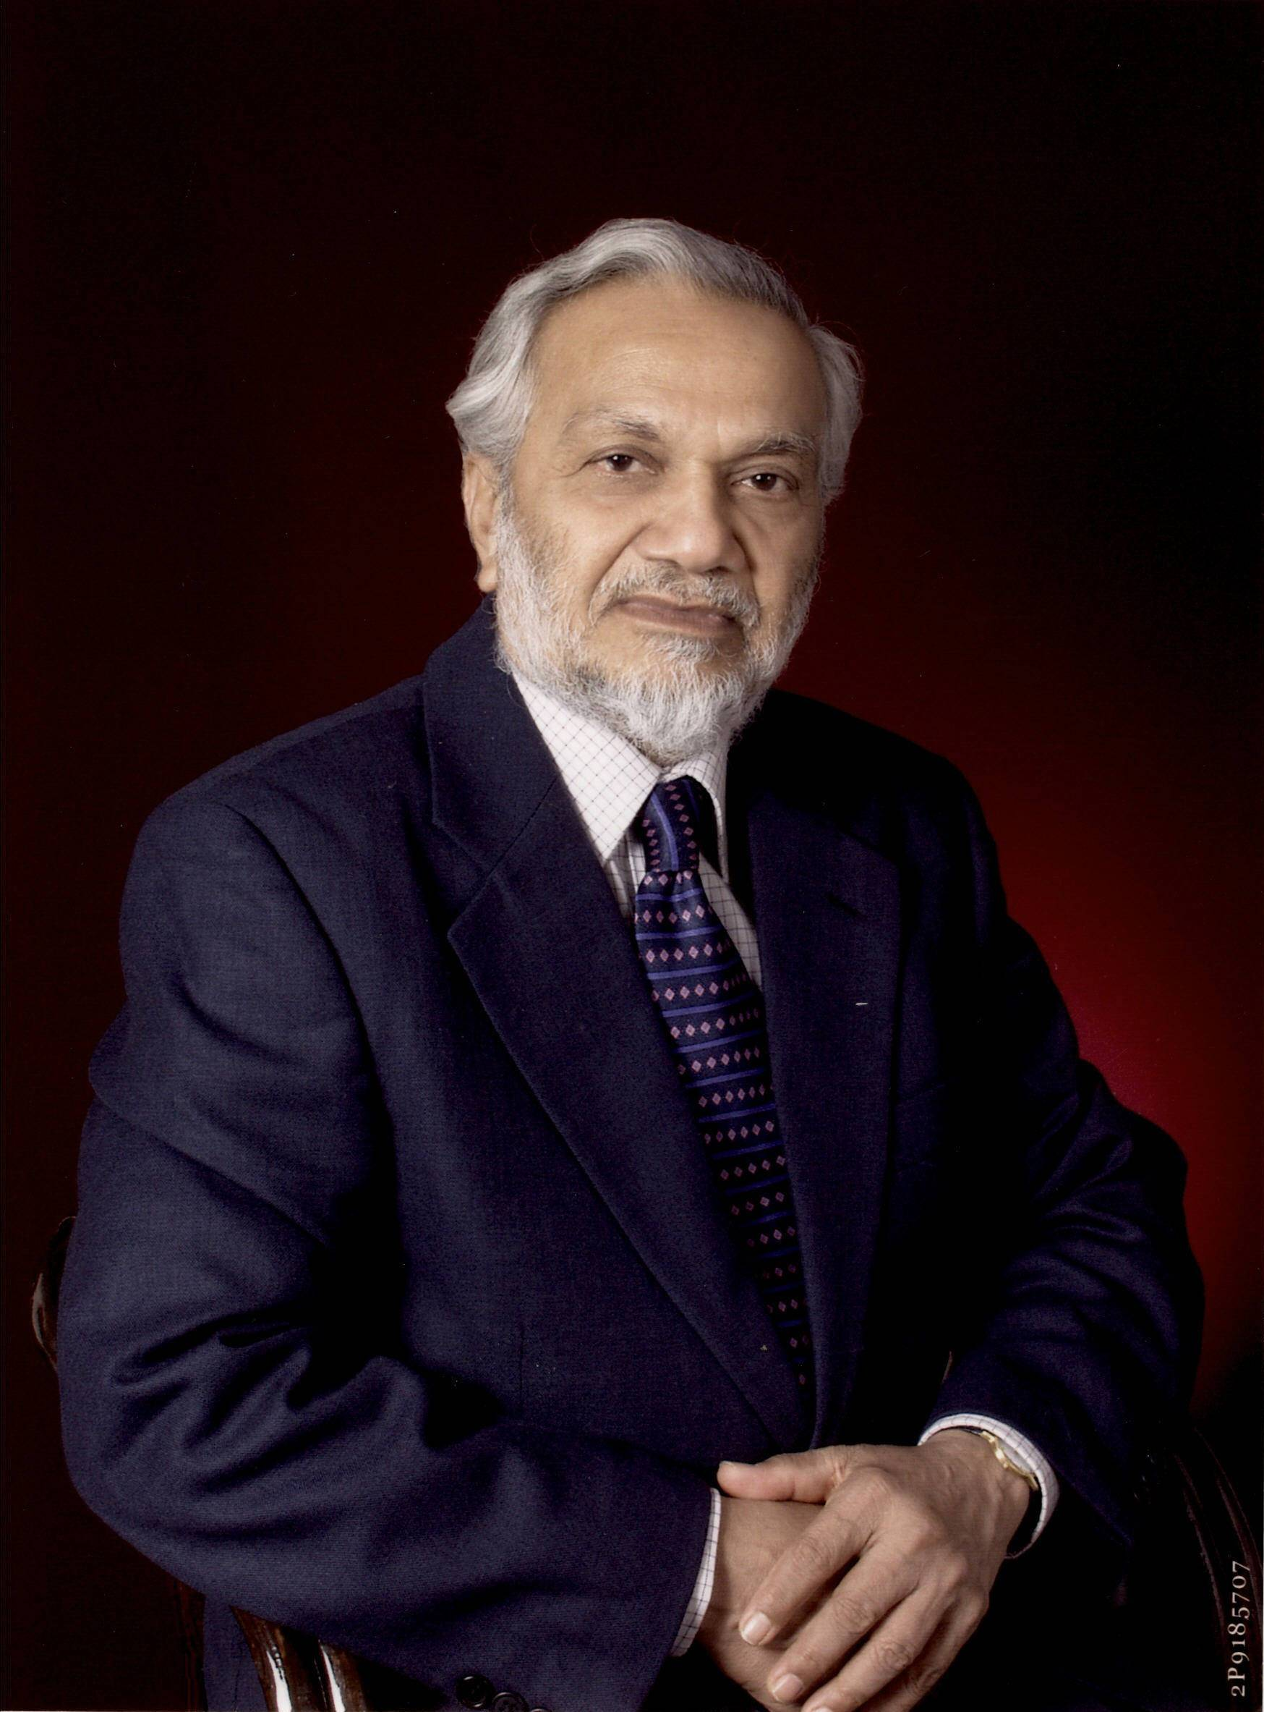
Bhikhu Chotala Parekh
Political theorist from India
Honorary Doctorate of Philosophy
(Nottingham Trent University)
Interest: Racial equality and
multiculturalism (Commission of Racial Equality)

Slide 3
Central Questions
WHY and WHAT obligations we have to people outside our political community and HOW best to discharge them?

Slide 4
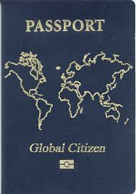
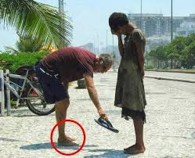
Main Ideas
“We HAVE obligations to our fellow citizens as well as to those outside our community” (p.3)
Global citizenship
Globally oriented national citizenship
Notes:
He tries to show why and what obligations we have to people outside our political community and how best to discharge them

Slide 5

Human beings are WORTHY to respect
  …. or have intrinsic worth, because of capacity of doing worthy things, and the worth is intrinsic based on capacities and achievements.
  1. Different capacities, but EQUAL worth of ALL Human beings
  2. Sharing common needs, vulnerabilities, etc.
  Enables to realize their potential and help create a rich and vibrant communal life from which all benefit
Notes:
Rethinking multiculturalism

Slide 6
2 Fundamental duties of moral beings
  A duty not to inflict evils on others and damage their ability to pursue their well-being
  A duty to alleviate their suffering and render them such help as they need and which we can provide within the limits of our abilities and resources.
But!
We have no duty to sacrifice our lives or vital interest for the sake of others, though we may do so if we feel so inclined, but we DO have a duty to make sacrifices of what is not vital for our well-being

Slide 7
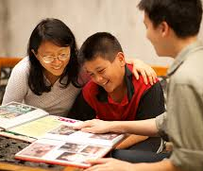
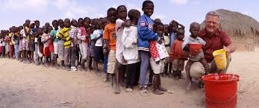
Special and General duties

Slide 8
Historical and contemporary factors to Human beings duties
Colonialism (West is responsible for for current life of post-colonial countries)
Technological advancement, environmental damage, etc.
Media, Internet, etc.
Global Interdenpendence

Slide 9
Ethics of Interdependence
  HUMAN KIND
  GLOBAL MORAL COMMUNITY
  POLITICAL COMMUNITY
“WE”

Slide 10
Globally oriented citizenship
Global or “cosmopolitan citizen”
Vs.
Globally oriented citizenship
Nationalism
Internationalism
Cosmopolitanism
Active empathy for human suffering (shared humanity and self-interest)

Slide 11
How to discharge
Globally Oriented Citizenship?
Constant analysis of the policies of one’s country
An active interest in the affairs of other countries
An active commitment to create a just world order

Slide 12
Globally oriented citizenship call for a delicate balance between several complementary virtues
How to cultivate and institutionalize virtues?
4x3
16x9

